Slide 1

CanberraUAV Workshop Ground Control Stations
Feb 2017

Slide 2
Ground Control Stations
Also known as GCS
Communicate with the UAV
Receive telemetry data
Send commands to UAV

Slide 3
GCS -Introduction
Telemetry Data
Data sent from UAV to GCS
Contains information about the current state of the UAV
Speed
Position
Altitude
System errors

Slide 4
GCS -Introduction
Command data
Data sent from GCS to UAV
Can be
Flight commands (RTL, Goto waypoint)
Get/set flight parameters
Get/set mission waypoints

Slide 5
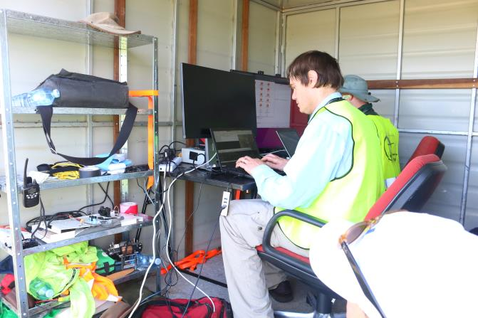
GCS -Introduction
A GCS Consists of
Communications Link
GCS Computer
GCS Software
Other accessories - live video feed, tracking antenna, DGPS base station, etc as required

Slide 6
GCS - Software Options
Most GCS software is run on laptops
Different options depending on
Which flight controller is used
GCS Operating System
Require features
Open source and commercial offerings

Slide 7
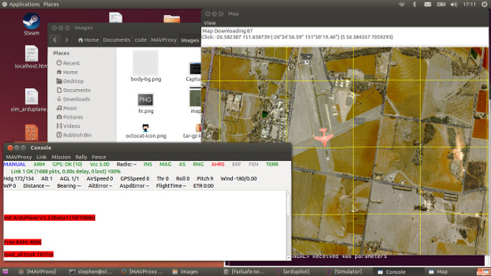
GCS - Software Options
Software | Runs on Linux | Runs on Windows | Runs on OSX
Mission Planner |  | YY | Y
MAVProxy | YY | Y
APM Planner 2 | YY | YY | YY
Qground control | Y | Y | YY
UgCS | YY | YY | YY

Slide 8
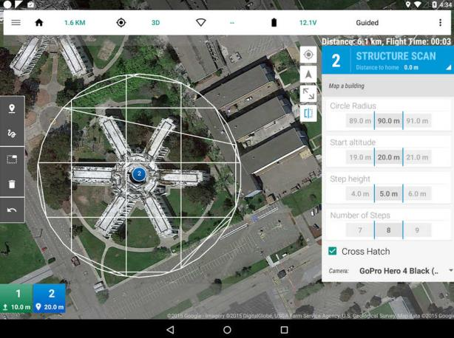
GCS - Software Options
Software | Runs on Android | Runs on iOS
Tower | YY
MAVPilot |  | YY
SidePilot |  | YY
AndroPilot | YY

Slide 9
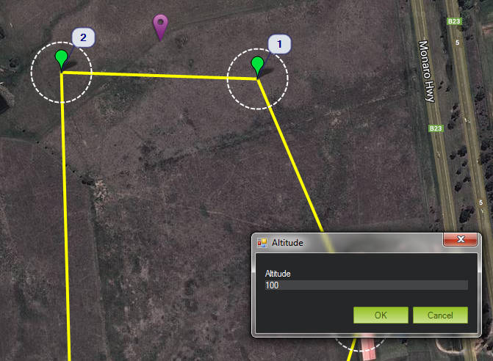
GCS - Software Options
Compatibility and features vary widely between GCS programs

Slide 10
GCS - MAVLink
Micro Air Vehicle Link
Standardised protocol for most open-source flight controllers
Though some flight controllers may have extra MAVLink messages
Efficient and low datarate
Includes CRC to ensure validity of data
3 versions - 0.9, 1.0, 2.0
Arduplane can use 1.0 or 2.0 (default 1.0)

Slide 11

GCS - MAVLink
Byte Index | Content | Value | Explanation
0 | Packet start sign | v1.0: 0xFE (v0.9: 0x55) | Indicates the start of a new packet.
1 | Payload length | 0 - 255 | Indicates length of the following payload.
2 | Packet sequence | 0 - 255 | Each component counts up his send sequence. Allows to detect packet loss
3 | System ID | 1 - 255 | ID of the SENDING system.
4 | Component ID | 0 - 255 | ID of the SENDING component.
5 | Message ID | 0 - 255 | ID of the message - the id defines what the payload “means” and how it should be correctly decoded.
6 to (n+6) | Data | (0 - 255) bytes | Data of the message, depends on the message id.
(n+7) to (n+8) | Checksum (low byte, high byte) | ITU X.25/SAE AS-4 hash, excluding packet start sign, so bytes 1..(n+6)

Slide 12
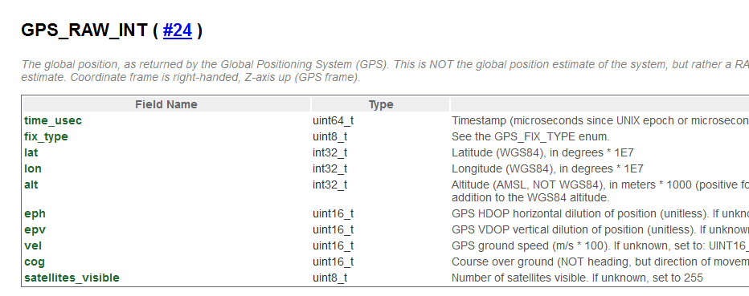
GCS - MAVLink

Slide 13
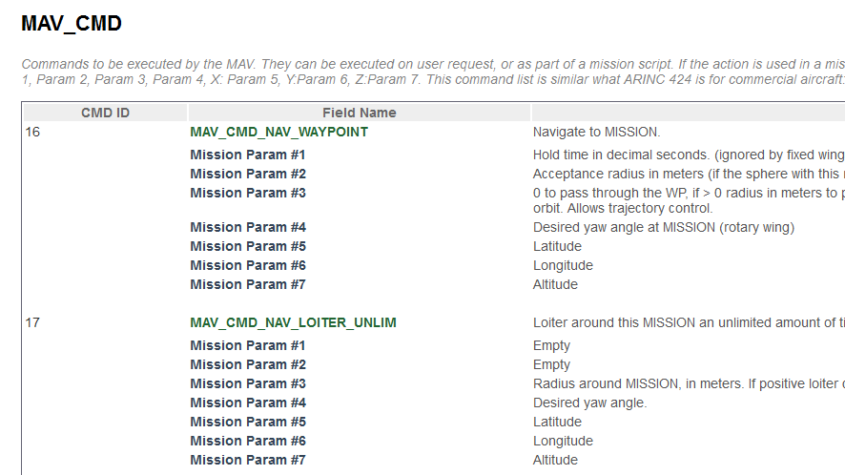
GCS - MAVLink

Slide 14
GCS - MAVLink
There are MAVLink messages for sending/receiving parameters and missions
Typically, a flight controller may only send some of the messages - depending on it’s features, settings and current state

Slide 15
GCS - MAVLink
MAVLink does include any encryption
Up to the user to implement in their communications link
MAVLink 2.0 includes a “signing key”
32-bit number
Flight controller will only accept commands from packet signed with this key
Disabled by default

Slide 16
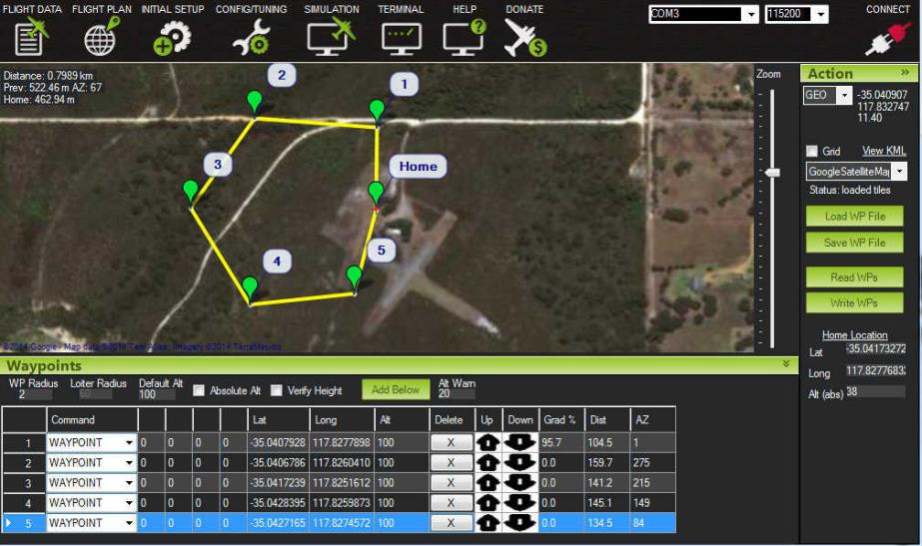
GCS - Flight Planning
Creating the waypoints to achieve the mission objectives

Slide 17
GCS - Flight Planning
What is the mission objective?
Primary and secondary goals
Payload required
UAV required
Most GCS software packages have a mission planning screen where you can drag-n-drop waypoints

Slide 18
GCS - Flight Planning
Considerations
Takeoff/landing area
Hills/Terrain
Flight altitude
Mission length (km)
Weather (wind)
Communications coverage

Slide 19

GCS - Flight Planning
If possible, run the mission in SITL beforehand, to ensure the waypoints are correctly laid out
Some GCS software packages have auto-generation of waypoints for mowing-the-lawn surveys

Slide 20
Practical Session 1 (20min)
Create a mission that:
Perform an aerial survey of the Snowy Hydro base
Considerations:
Takeoff/landing at CMAC
Landing will be manual
Create the mission, run in SITL
cd ./ArduPlane
../Tools/autotest/sim_vehicle.py
Two options for GCS tool to use for mission planning (choose one)
Connect Mission Planner via UDP, port 14550
Use module load misseditor in MAVProxy

Slide 21
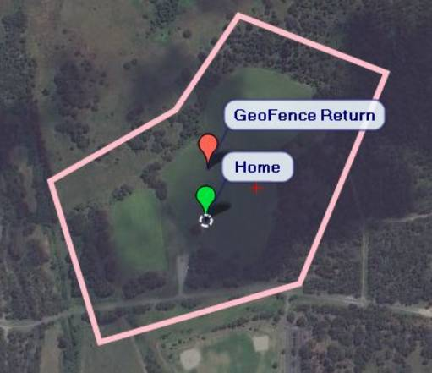
GCS - Advanced Planning
Geofences
A single closed polygon
UAV will turn back if it crosses outside of the polygon
Note that the UAV’s inertia may send it beyond the fence for a short period

Slide 22
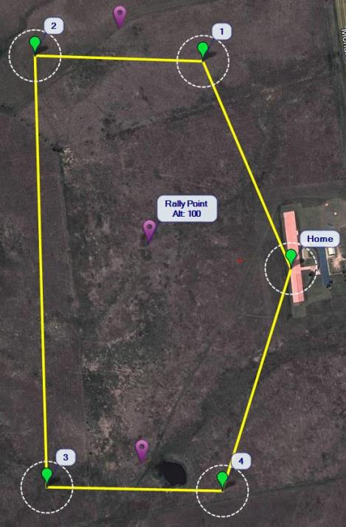
GCS - Advanced Planning
Rally points
Instead of a single Home point, have a set of rally points
On RTL, the UAV will head to the nearest rally point

Slide 23
GCS - Advanced Planning
Terrain Following
Terrain data stored on Pixhawk’s SD card
Arduplane will look at this database to estimate it’s AGL
Available in AUTO, RTL and other flight modes. Will maintain a constant height above ground
Set TERRAIN_ENABLE to 1 and TERRAIN_FOLLOW to 1
Note the datasource is the SRTM data, so is only accurate to 20m

Slide 24
GCS - Post flight analysis
Two types of logfiles
GCS - saved copy of MAVlink stream (tlog)
APM - saved on SD card (bin)
Bin log has more messages at a faster rate
Generally the preferred log when analysing a flight
Tlog is on the GCS, so can be used if the UAV goes missing or is destroyed
Still worth searching the crash site for the SD card!

Slide 25
GCS - Post flight analysis
Tlogs are stored in:
Mission Planner
C:\Program Files (x86)\Mission Planner\logs
MAVProxy
Same folder that MAVproxy was run from (unless using the --aircraft option)

Slide 26
GCS - Post flight analysis
Most flight analysis tools will work with both bin files and tlog files
Popular Flight Analysis tools:
Mission Planner
MAVExplorer (part of MAVProxy)

Slide 27
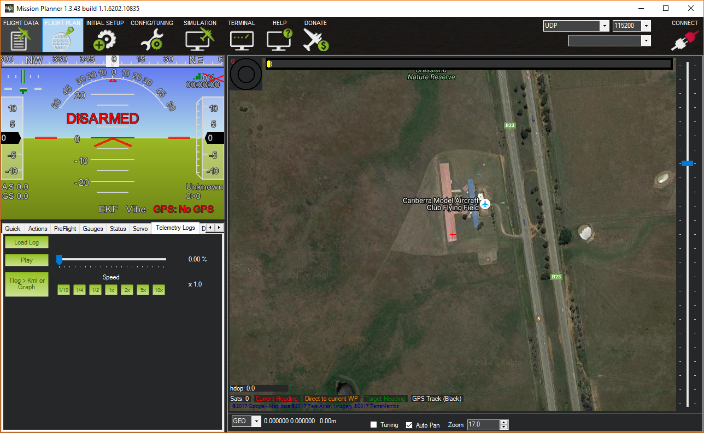
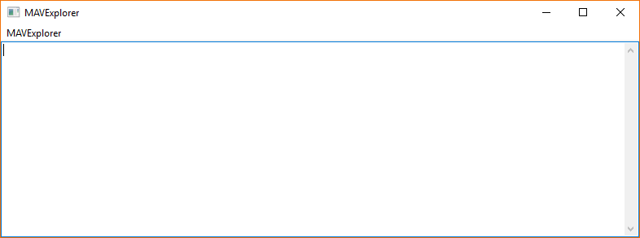
GCS - Post flight analysis

Slide 28
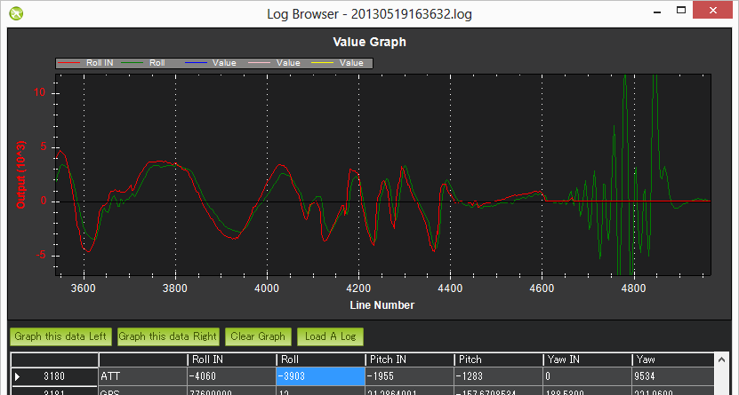
GCS - Post flight analysis
Mechanical Failures
These appear in the log as a sudden divergence in the desired roll and pitch vs the vehicles actual roll and pitch

Slide 29
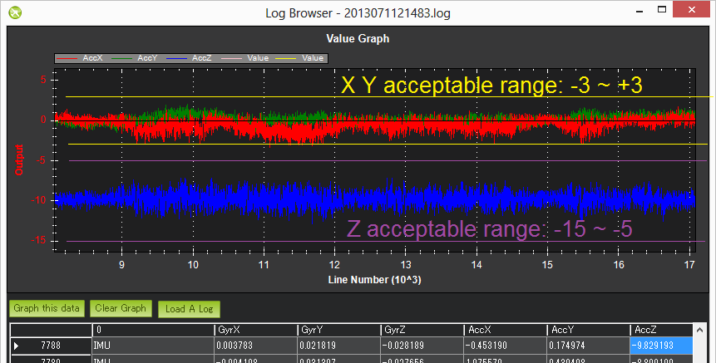
GCS - Post flight analysis
Excessive Vibration

Slide 30
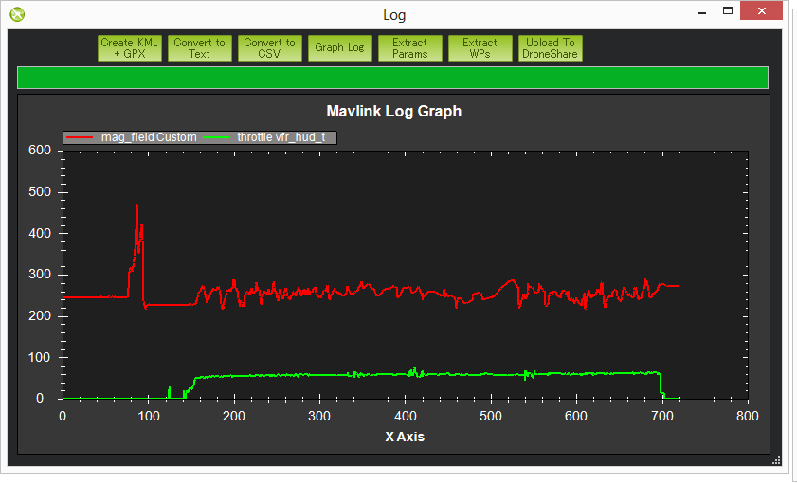
GCS - Post flight analysis
Compass Interference
Look for patterns between mag_field and throttle

Slide 31
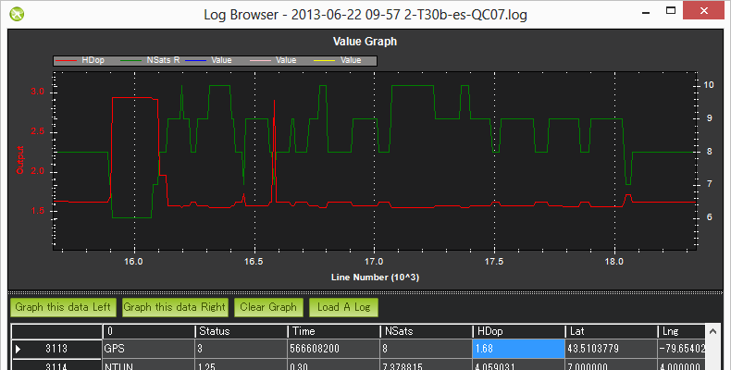
GCS - Post flight analysis
GPS Glitches

Slide 32
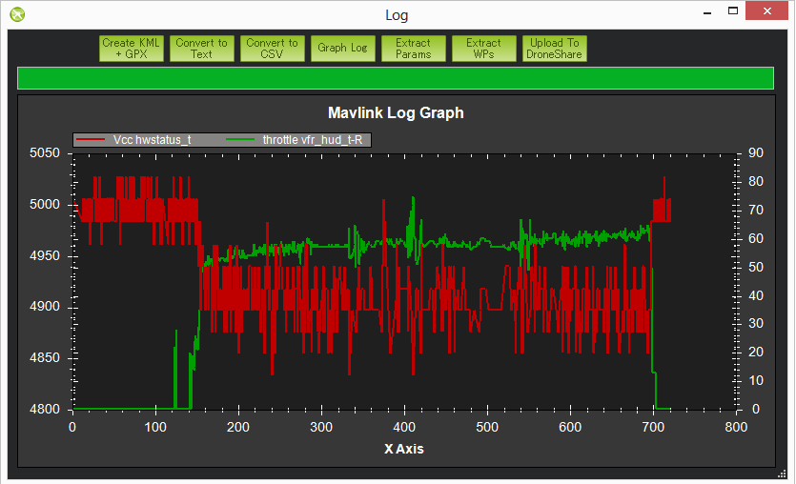
GCS - Post flight analysis
Power brown-outs, if APM voltage varies by more than 0.15V, or goes below 4.7V

Slide 33
Practical Session 2 (20min)
Logfile Analysis
Find a logfile generated by SITL(./ArduPlane/logs) for the bin file
For more interesting data: http://discuss.ardupilot.org/t/altitude-hold-and-stability/14536
Two options for Analysis tool (choose one)
Mission Planner
MAVExplorer
Check GPS
GPS.Nsats and GPS.HDop messages
Check Vibration
IMU.AccX, IMU.AccY, IMU.AccZ messages

Slide 34
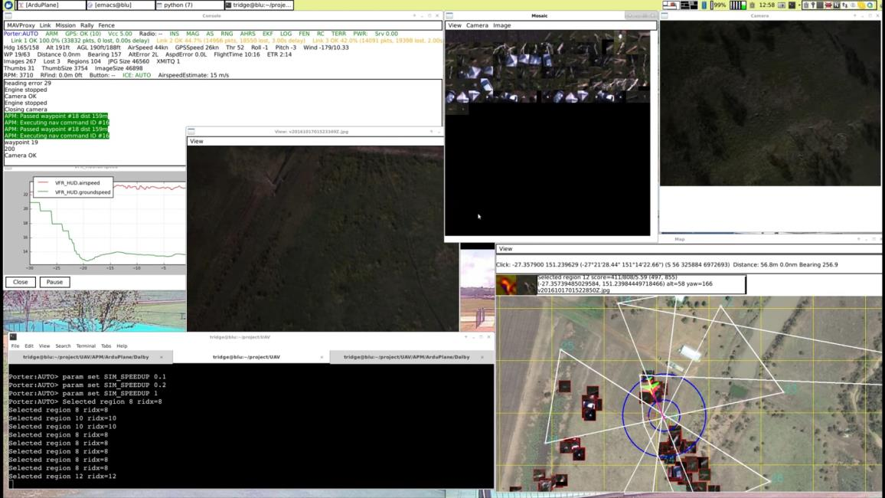
GCS - Inflight Monitoring
APM outputs a lot of telemetry data
How to watch all this in realtime?

Slide 35
GCS - Inflight Monitoring
Decide which data is important
May vary depending on mission phase
Speed, Altitude during takeoff and landing
Moving map during mission

Slide 36
GCS - Inflight Monitoring
Things to typically monitor
Speed
Altitude
UAV Position (longitude/latitude) along with waypoints
Battery voltage
Telemetry link quality
Any error messages
Anything that, if not detected in a short time, could result in a crash

Slide 37
GCS - Inflight Monitoring
Have backup plans for common failure scenarios
Practice!
In SITL
In test flights
Consider having multiple GCS stations to split the workload

Slide 38
The End!
Flight Planning
Logfile analysis
Inflight monitoring

